Slide 1
Chapter 2 Tutorial
IT323 Data Mining

Slide 2
Basic Statistical Measures

Slide 3

Measuring the Central Tendency
Mean:
The mean is equal to the sum of all the values in the data set divided by the number of values in the data set.
Median:
Middle value if odd number of values, or average of the middle two values otherwise.
Mode:
Value that occurs most frequently in the data.
Data sets with one, two, or three modes are respectively called unimodal, bimodal, and trimodal.
Midrange:
It is the average of the largest and smallest values in the set.
$$\bar{x}=\frac{\sum_{i=1}^{n}{x_{i}}}{n}$$
Notes:
Sometimes, each value xi in a set may be associated with a weight wi for i = 1, .. ,n.
The weights reflect the significance, importance, or occurrence frequency attached to their respective values
To offset the effect caused by a small number of extreme values, we can instead use the trimmed mean, which is the mean obtained after chopping off values at the high and low extremes.
For example, we can sort the values observed for salary and remove the top and bottom 2% before computing the mean.

Slide 4
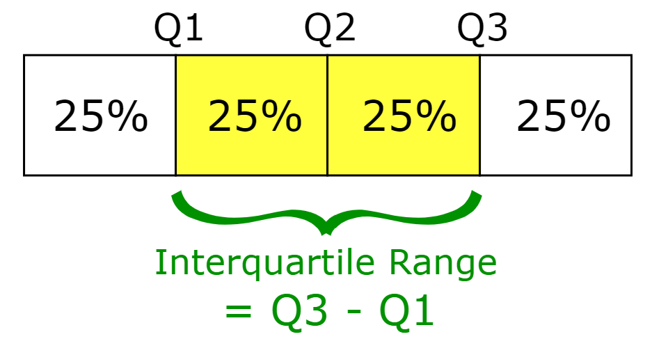
Measuring the Dispersion of Data
Range:
The difference between the largest and smallest values.
Quartiles:
The values that divide a list of numbers into quarters
Interquartile Range:
Inter-quartile range: IQR = Q3 – Q1
Outliers:
A value higher/lower than 1.5 x IQR
Notes:
The 4-quantiles are the three data points that split the data distribution into four equal parts; each part represents one-fourth of the data distribution. They are more commonly referred to as quartiles. The 100-quantiles are more commonly referred to as percentiles; they divide the data distribution into 100 equal-sized consecutive sets.
The quartiles give an indication of a distribution’s center, spread, and shape.
The first quartile, denoted by Q1, is the 25th percentile. It cuts off the lowest 25% of the data.
The third quartile, denoted by Q3, is the 75th percentile—it cuts off the lowest 75% (or highest 25%) of the data.
The second quartile is the 50th percentile. As the median, it gives the center of the data distribution.
The distance between the first and third quartiles is a simple measure of spread that gives the range covered by the middle half of the data.
This distance is called the interquartile range (IQR).

Slide 5
Measuring the Dispersion of Data
Five-Number Summary:
Minimum, Q1, Median, Q3, Maximum
Boxplots:
graphic display of five-number summary.
Data is represented with a box
The ends of the box are at the first and third quartiles, i.e., the height of the box is IQR
The median is marked by a line within the box
Whiskers: two lines outside the box extended to Minimum and Maximum
Outliers: points beyond a specified outlier threshold, plotted individually
Notes:
A boxplot incorporates the five-number summary as follows:
Typically, the ends of the box are at the quartiles so that the box length is the interquartile range.
The median is marked by a line within the box.
Two lines (called whiskers) outside the box extend to the smallest (Minimum) and largest (Maximum) observations.
Boxplot. Figure 2.3 shows boxplots for unit price data for items sold at four branches of AllElectronics during a given time period.
For branch 1, we see that the median price of items sold is $80, Q1 is $60, and Q3 is $100.
Notice that two outlying observations for this branch were plotted individually, as their values of 175 and 202 are more than 1.5 times the IQR here of 40.
Branch 1:
IQR=Q3-Q1=100-60=40
IQR*1.5=60
IF x > 60+Q3 OR x< Q1-60 THEN x is outlier

Slide 6
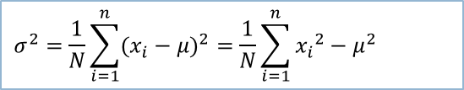
Measuring the Dispersion of Data
Variance (or σ²):
Indicate how spread out a data distribution is.
Standard deviation (or σ):
The square root of variance.
$$σ^{2}=\frac{1}{N}\sum_{i=1}^{n}{(x_{i}−μ)^{2}}=\frac{1}{N}\sum_{i=1}^{n}{{x_{i}}^{2}−μ^{2}}$$
Notes:
A low standard deviation means that the data observations tend to be very close to the mean.
A high standard deviation indicates that the data are spread out over a large range of values.

Slide 7
Boxplot Example 1
Draw the boxplot For the following set
1
1
3
5
6
6
7
8
12
13
15
Min=
Q1=
Median=
Q3=
Max=
Inter Quartile Range (IQR)= Q3-Q1
Outliers = Min_outlier < Q1- 1.5×IQR
Max_outlier > Q3+1.5×IQR

Slide 8
Boxplot Example 1
Draw the boxplot For the following set
Min | 1
 | 1
Q1 | 3
 | 5
 | 6
Median | 6
 | 7
 | 8
Q3 | 12
 | 13
Max | 15
Min= 1
Q1= 3
Median= 6
Q3= 12
Max= 15
Inter Quartile Range (IQR)= Q3-Q1 = 12-3=9
1.5×IQR = 1.5×9 = 13.5
Outliers = Min_outlier < Q1- 1.5×IQR
Min_outlier < 3-13.5= -10.5
Max_outlier > Q3+1.5×IQR
Max_outlier > 12+13.5= 25.5

Slide 9
Boxplot Example 1
Min=1
Q1=3
Median=6
Q3=12
Max=15

Slide 10
Boxplot Example 2
Draw the boxplot For the following set
2
3
3
6
7
7
7
9
13
15
30
Min=
Q1=
Median=
Q3=
Max=
Inter Quartile Range (IQR)= Q3-Q1
Outliers = Min_outlier < Q1- 1.5×IQR
Max_outlier > Q3+1.5×IQR

Slide 11
Boxplot Example 2
Min | 2
 | 3
Q1 | 3
 | 6
 | 7
Median | 7
 | 7
 | 9
Q3 | 13
 | 15
Max | 30
Min= 2
Q1= 3
Median= 7
Q3= 13
Max= 30
Inter Quartile Range (IQR)= Q3-Q1 = 13-3=10
1.5×IQR = 1.5×10 = 15
Outliers = Min_outlier < Q1- 1.5×IQR
Min_outlier < 3-15= -12
Max_outlier > Q3+1.5×IQR
Max_outlier > 13+15= 28

Slide 12
Boxplot Example 2
Min=2
Q1=3
Median=7
Q3=13
Max=30
Q1- 1.5×IQR=-12
Q3+1.5×IQR=28

Slide 13
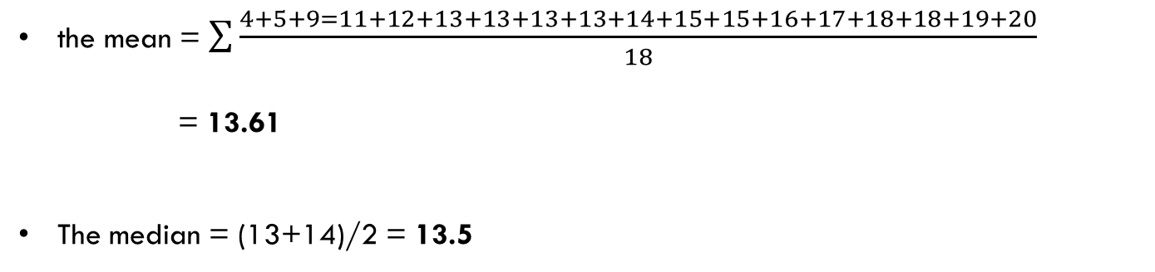
Question#2: Suppose that the data for analysis includes the attribute grade. The grade values for the data tuples are: 4, 5, 9, 11, 12, 13, 13, 13, 13, 14, 15, 15, 16, 17, 18, 18, 19, 20
(a) What is the mean of the data? What is the median?
the mean = $\sum{\frac{4+5+9=11+12+13+13+13+13+14+15+15+16+17+18+18+19+20}{18}}$
= 13.61
The median = (13+14)/2 = 13.5

Slide 14
Question#2: Suppose that the data for analysis includes the attribute grade. The grade values for the data tuples are: 4, 5, 9, 11, 12, 13, 13, 13, 13, 14, 15, 15, 16, 17, 18, 18, 19, 20
(b) What is the mode of the data? Comment on the data's modality (i.e., bimodal, trimodal, etc.).
The mode:13
The mode is only one value, so it’s called unimodal.

Slide 15
Question#2: Suppose that the data for analysis includes the attribute grade. The grade values for the data tuples are: 4, 5, 9, 11, 12, 13, 13, 13, 13, 14, 15, 15, 16, 17, 18, 18, 19, 20
(c) What is the midrange of the data?
Midrange = (20+ 4) / 2 = 12

Slide 16
Question#2: Suppose that the data for analysis includes the attribute grade. The grade values for the data tuples are: 4, 5, 9, 11, 12, 13, 13, 13, 13, 14, 15, 15, 16, 17, 18, 18, 19, 20
(d) Can you find (roughly) the first quartile (Q1) and the third quartile (Q3) of the data?
The first quartile (corresponding to the 25th percentile) of the data is: (11+12)/2=11.5
The third quartile (corresponding to the 75th percentile) of the data is: (17+18)/2=17.5

Slide 17
Question#2: Suppose that the data for analysis includes the attribute grade. The grade values for the data tuples are: 4, 5, 9, 11, 12, 13, 13, 13, 13, 14, 15, 15, 16, 17, 18, 18, 19, 20
(e) Give the five-number summary of the data.
The five-number summary of a distribution consists of the minimum value, first quartile, median value, third quartile, and maximum value.
Min= 4
Q1=11.5
Median=13.5
Q3=17.5
Max=20

Slide 18
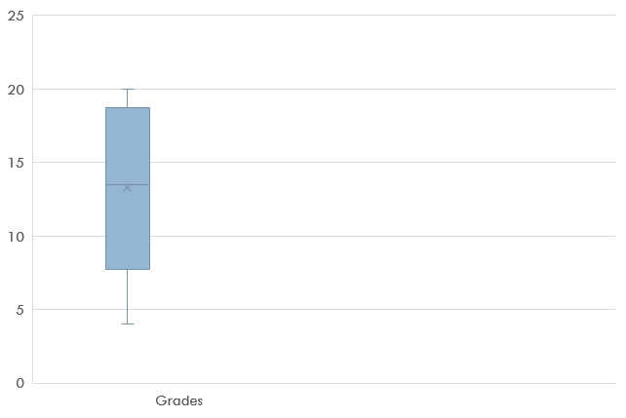
Question#2: Suppose that the data for analysis includes the attribute grade. The grade values for the data tuples are: 4, 5, 9, 11, 12, 13, 13, 13, 13, 14, 15, 15, 16, 17, 18, 18, 19, 20
(f) Show a boxplot of the data.
Min=4
Q1=11.5
Median=13.5
Q3=17.5
Max=20

Slide 19
Question#3: Suppose that the data for analysis includes the attribute age. The age values for the data tuples are: 13, 15, 16, 16, 19, 20, 20, 21, 22, 22, 25, 25, 25, 25, 30, 33, 33, 35, 35, 35, 35, 36, 40, 45,46, 52, 70
(a) What is the mean of the data? What is the median?
The mean of the data is: = 809/27 = 30
The median of the data is = 25

Slide 20
Question#3: Suppose that the data for analysis includes the attribute age. The age values for the data tuples are: 13, 15, 16, 16, 19, 20, 20, 21, 22, 22, 25, 25, 25, 25, 30, 33, 33, 35, 35, 35, 35, 36, 40, 45,46, 52, 70
(b) What is the mode of the data? Comment on the data's modality (i.e., bimodal, trimodal, etc.).
The modes of the data are 25 and 35
This data set has two values that occur with the same highest frequency and is, therefore, bimodal.

Slide 21
Question#3: Suppose that the data for analysis includes the attribute age. The age values for the data tuples are: 13, 15, 16, 16, 19, 20, 20, 21, 22, 22, 25, 25, 25, 25, 30, 33, 33, 35, 35, 35, 35, 36, 40, 45,46, 52, 70.
(c) What is the midrange of the data?
The midrange of the data is: (70+13)/2 = 41.5

Slide 22
Question#3: Suppose that the data for analysis includes the attribute age. The age values for the data tuples are: 13, 15, 16, 16, 19, 20, 20, 21, 22, 22, 25, 25, 25, 25, 30, 33, 33, 35, 35, 35, 35, 36, 40, 45,46, 52, 70.
(d) Can you find (roughly) the first quartile (Q1) and the third quartile (Q3) of the data?
The first quartile (corresponding to the 25th percentile) of the data is: 20
The third quartile (corresponding to the 75th percentile) of the data is: 35

Slide 23
Question#3: Suppose that the data for analysis includes the attribute age. The age values for the data tuples are: 13, 15, 16, 16, 19, 20, 20, 21, 22, 22, 25, 25, 25, 25, 30, 33, 33, 35, 35, 35, 35, 36, 40, 45,46, 52, 70.
(e) Give the five-number summary of the data.
Min=13
Q1=20
Median=25
Q3=35
Max=70

Slide 24
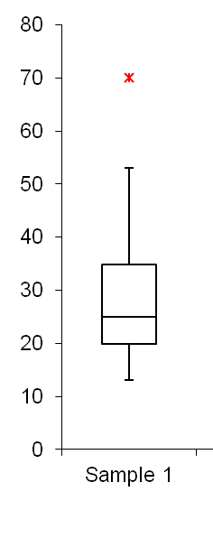
Question#3: Suppose that the data for analysis includes the attribute age. The age values for the data tuples are: 13, 15, 16, 16, 19, 20, 20, 21, 22, 22, 25, 25, 25, 25, 30, 33, 33, 35, 35, 35, 35, 36, 40, 45,46, 52, 70.
(f) Show a boxplot of the data.
Min=13
Q1=20
Median=25
Q3=35
Max=70
IQR=35-20=15
1.5×IQR=22.5
Q1- 1.5×IQR=-2.5
Q3+1.5×IQR=57.5

Slide 25


Question#4: Suppose a hospital tested the age and body fat data for 18 randomly selected adults with the following result
Age | Body Fat
23 | 9.5
23 | 26.5
27 | 7.8
27 | 17.8
39 | 31.4
41 | 25.9
47 | 27.4
49 | 27.2
50 | 31.2
52 | 34.6
54 | 42.5
54 | 28.8
56 | 33.4
57 | 30.2
58 | 34.1
58 | 32.9
60 | 41.2
61 | 35.7
(a) Calculate the mean, median and standard deviation of age and score.
For variable Age:
Mean = (836/18) = 46.44
Median = (50+52)/2=51
Standard deviation =
Variance $σ^{2}$ = 165.02469135802
$=$ $\frac{{(23−46.44)}^{2}+………{+(61−46.44)}^{2}}{18}$
= $\frac{2970.44}{18}=165.02469135802$
Standard deviation = $\sqrt{σ^{2}}$
= $\sqrt{165.02469135802}$
=12.846
$$σ^{2}=\frac{1}{N}\sum_{i=1}^{n}{(x_{i}−μ)^{2}}=\frac{1}{N}\sum_{i=1}^{n}{{x_{i}}^{2}−μ^{2}}$$

Slide 26
Question#4: Suppose a hospital tested the age and body fat data for 18 randomly selected adults with the following result
Age | Sorted Body Fat
23 | 7.8
23 | 9.5
27 | 17.8
27 | 25.9
39 | 26.5
41 | 27.2
47 | 27.4
49 | 28.8
50 | 30.2
52 | 31.2
54 | 31.4
54 | 32.9
56 | 33.4
57 | 34.1
58 | 34.6
58 | 35.7
60 | 41.2
61 | 42.5
(a) Calculate the mean, median and standard deviation of age and score.
For variable score:
Mean = (518.1/18)=28.78
Median = (30.2+31.2)/2= 30.7
Standard deviation = 8.99

Slide 27
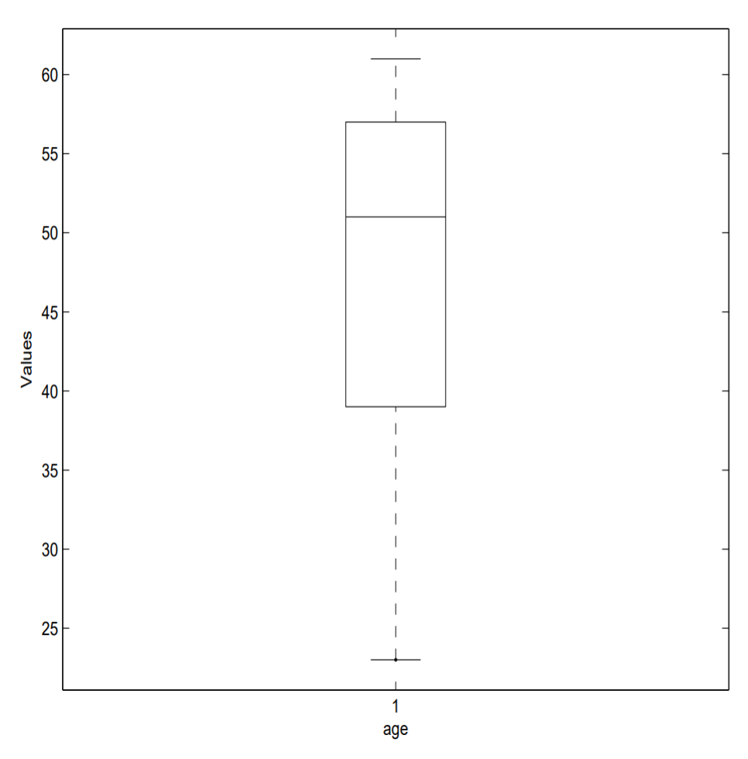
Question#4: Suppose a hospital tested the age and body fat data for 18 randomly selected adults with the following result
Age | Sorted Body Fat
23 | 7.8
23 | 9.5
27 | 17.8
27 | 25.9
39 | 26.5
41 | 27.2
47 | 27.4
49 | 28.8
50 | 30.2
52 | 31.2
54 | 31.4
54 | 32.9
56 | 33.4
57 | 34.1
58 | 34.6
58 | 35.7
60 | 41.2
61 | 42.5
(b) Draw the box-plots for age and score.

Slide 28
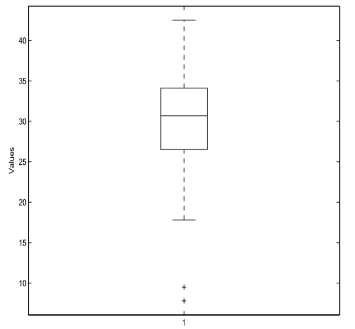
Question#4: Suppose a hospital tested the age and body fat data for 18 randomly selected adults with the following result
Age | Sorted Body Fat
23 | 7.8
23 | 9.5
27 | 17.8
27 | 25.9
39 | 26.5
41 | 27.2
47 | 27.4
49 | 28.8
50 | 30.2
52 | 31.2
54 | 31.4
54 | 32.9
56 | 33.4
57 | 34.1
58 | 34.6
58 | 35.7
60 | 41.2
61 | 42.5
(b) Draw the box-plots for age and score.

Slide 29
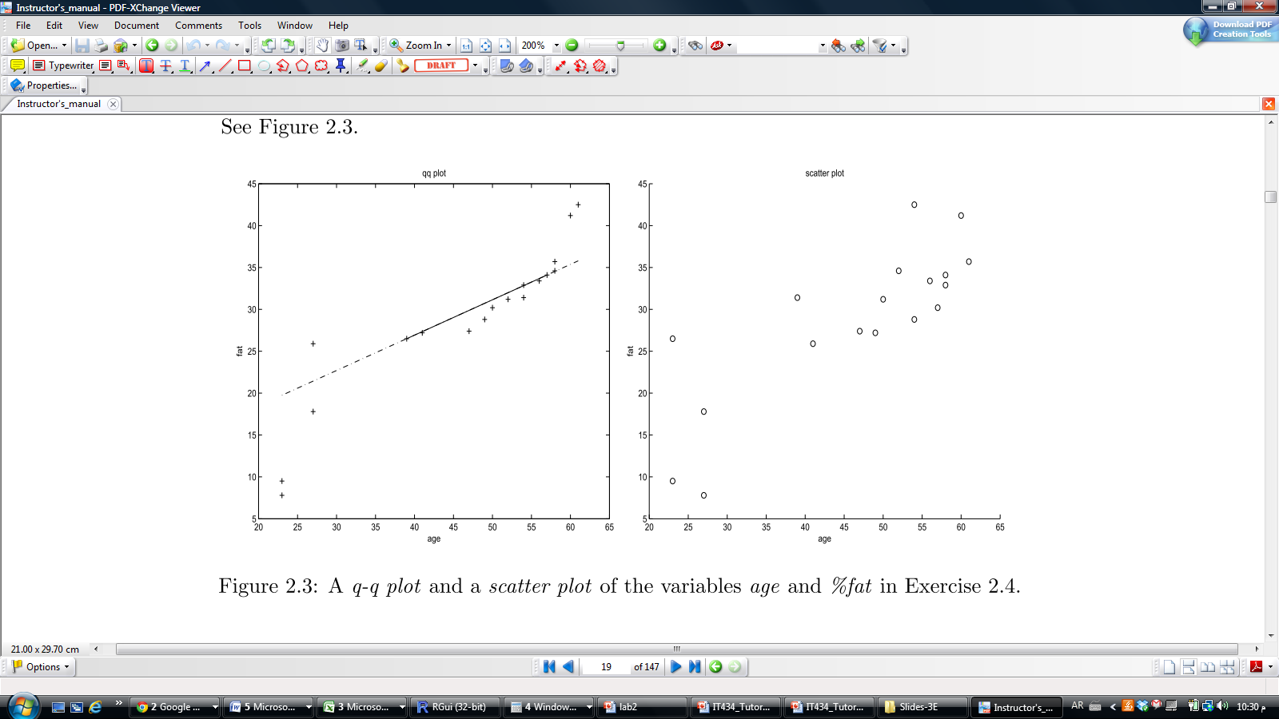
Question#4: Suppose a hospital tested the age and body fat data for 18 randomly selected adults with the following result
Age | Sorted Body Fat
23 | 7.8
23 | 9.5
27 | 17.8
27 | 25.9
39 | 26.5
41 | 27.2
47 | 27.4
49 | 28.8
50 | 30.2
52 | 31.2
54 | 31.4
54 | 32.9
56 | 33.4
57 | 34.1
58 | 34.6
58 | 35.7
60 | 41.2
61 | 42.5
(c) q-q plot based on these two variables.

Slide 30
Question#4: Suppose a hospital tested the age and body fat data for 18 randomly selected adults with the following result
Age | Sorted Body Fat
23 | 7.8
23 | 9.5
27 | 17.8
27 | 25.9
39 | 26.5
41 | 27.2
47 | 27.4
49 | 28.8
50 | 30.2
52 | 31.2
54 | 31.4
54 | 32.9
56 | 33.4
57 | 34.1
58 | 34.6
58 | 35.7
60 | 41.2
61 | 42.5
(d) Draw a scatter plot based on these two variables.

Slide 31
Measuring Data Similarity and Dissimilarity

Slide 32
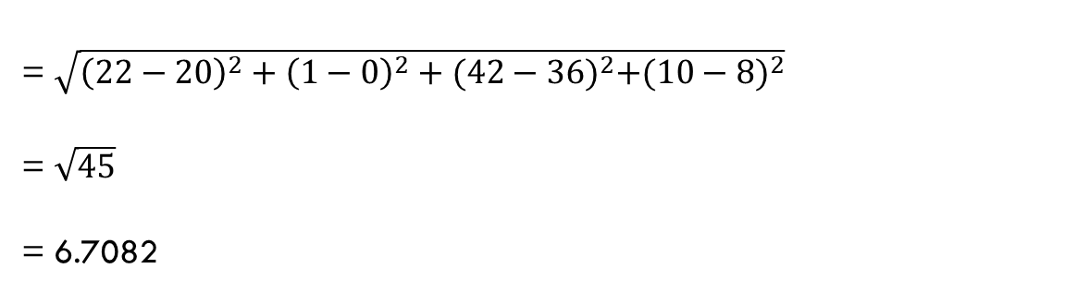
Question#5: Given two objects represented by the tuples (22, 1, 42, 10) and (20, 0, 36, 8)
(a) Compute the Euclidean distance between the two objects.
= $\sqrt{{\left(22−20\right)}^{2}+{\left(1−0\right)}^{2}+{(42−36)}^{2}+{(10−8)}^{2}}$
= $\sqrt{45}$
= 6.7082

Slide 33
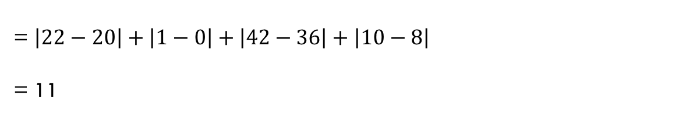
Question#5: Given two objects represented by the tuples (22, 1, 42, 10) and (20, 0, 36, 8)
(b) Compute the Manhattan distance between the two objects.
= $\left|22−20\right|+\left|1−0\right|+\left|42−36\right|+\left|10−8\right|$
= 11

Slide 34
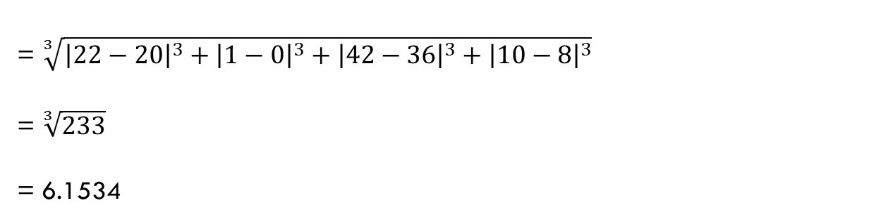
Question#5: Given two objects represented by the tuples (22, 1, 42, 10) and (20, 0, 36, 8)
c) Compute the Minkowski distance between the two objects, using h = 3
= $\sqrt[3]{{\left|22−20\right|}^{3}+{\left|1−0\right|}^{3}+{\left|42−36\right|}^{3}+{\left|10−8\right|}^{3}}$
= $\sqrt[3]{233}$
= 6.1534

Slide 35
Example #5: Cosine Similarity
Compute the Cosine similarity for the following document-term matrix?

Slide 36
Example #5: Cosine Similarity Cont…
Dot-Product(Doc2,Doc4) = <3,1,4,3,1,2,0,1> * <0,1,0,3,0,0,2,0>
= 0 + 1 + 0 + 9 + 0 + 0 + 0 + 0 = 10
Norm (Doc2) = SQRT(9+1+16+9+1+4+0+1) = 6.4
Norm (Doc4) = SQRT(0+1+0+9+0+0+4+0) = 3.74
Cosine(Doc2, Doc4) = 10 / (6.4 * 3.74) = 0.42

